Slide 1

Sprocket Central Pty Ltd
THE Analytics Team
Data Analytics approach
Prime Division- Tony Smith, Kirt Preet Singh, Jane Watson

Slide 2
Agenda
1. INTRODUCTION
2. Data exploration
2. Model development.
3. INTERPRETATION

Slide 3
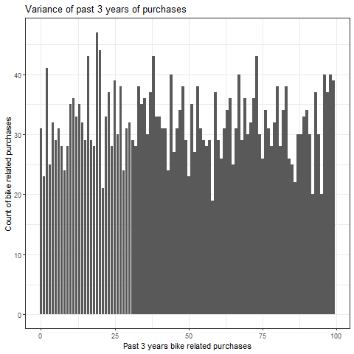
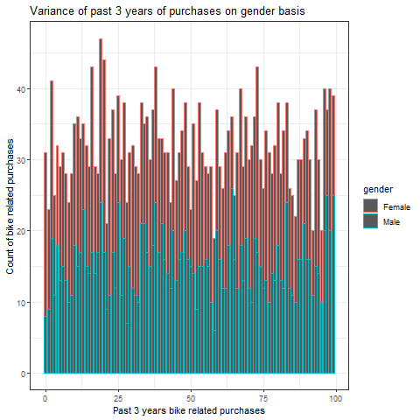
Introduction
In order to build a Business Strategy for the future, we must realize the factors that affected the purchases in the past. Given here are the two images, the one on the top explains the variance in past 3 years of purchases whereas, the one on the bottom, shows the variance of purchases with respect to gender. Our goal is to gather enough such variables that effectively explain the variance in the purchases.

Slide 4
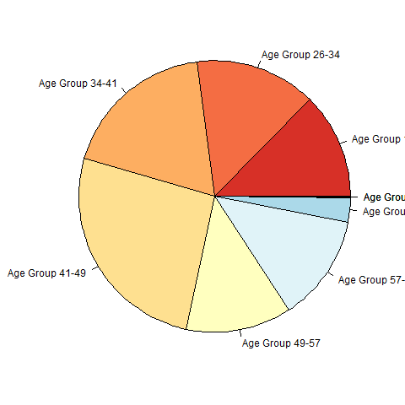
Data Exploration
Age Groups of buyers peaked our interest, and as we see there are significant variances in the amount of purchases with respect to the age groups our buyers belong to, which seems to be an interesting insight exploring the data.

Slide 5
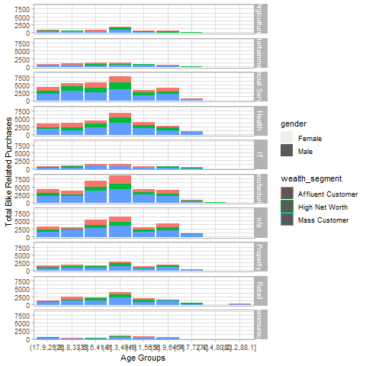
Model Development
The model built here includes, of some variables that in our exploratory approach seemed to explain the variance in the past purchases, the exploratory analysis was somewhat cross verified with a statistical approach as well, the included variables are:
Gender
Wealth Segment
Decreased Indicator
Age
Job Industry Category

Slide 6
Interpretation
Having a basic idea what variables in the data sets provided might be impacting the purchases over the past 3 years we can finally head towards the model selection, intensifying the statistical methodology, reaching up to this mark, we just need to observe trends and patterns in the peaks of purchases.
Following the above a business strategy will be developed, which would help us identify the customers to be targeted.

Slide 7
We look forward to the next step…..
~Data Analytics Team

